Slide 1
Conditional statements

Slide 2
Outline
In this lesson, we will:
  Describe the need for executing code conditionally
  Describe the flow chart and emphasize the purpose of flow charts
  Describe the conditional statement
    The absolute-value and max functions
  Look at multiple conditional statements
    Clipping and the tent function
  Look at a simplification if there is no code to run if the statement is false
    The sinc function
  Finally, concluding with a simulation of the operational amplifier

Slide 3
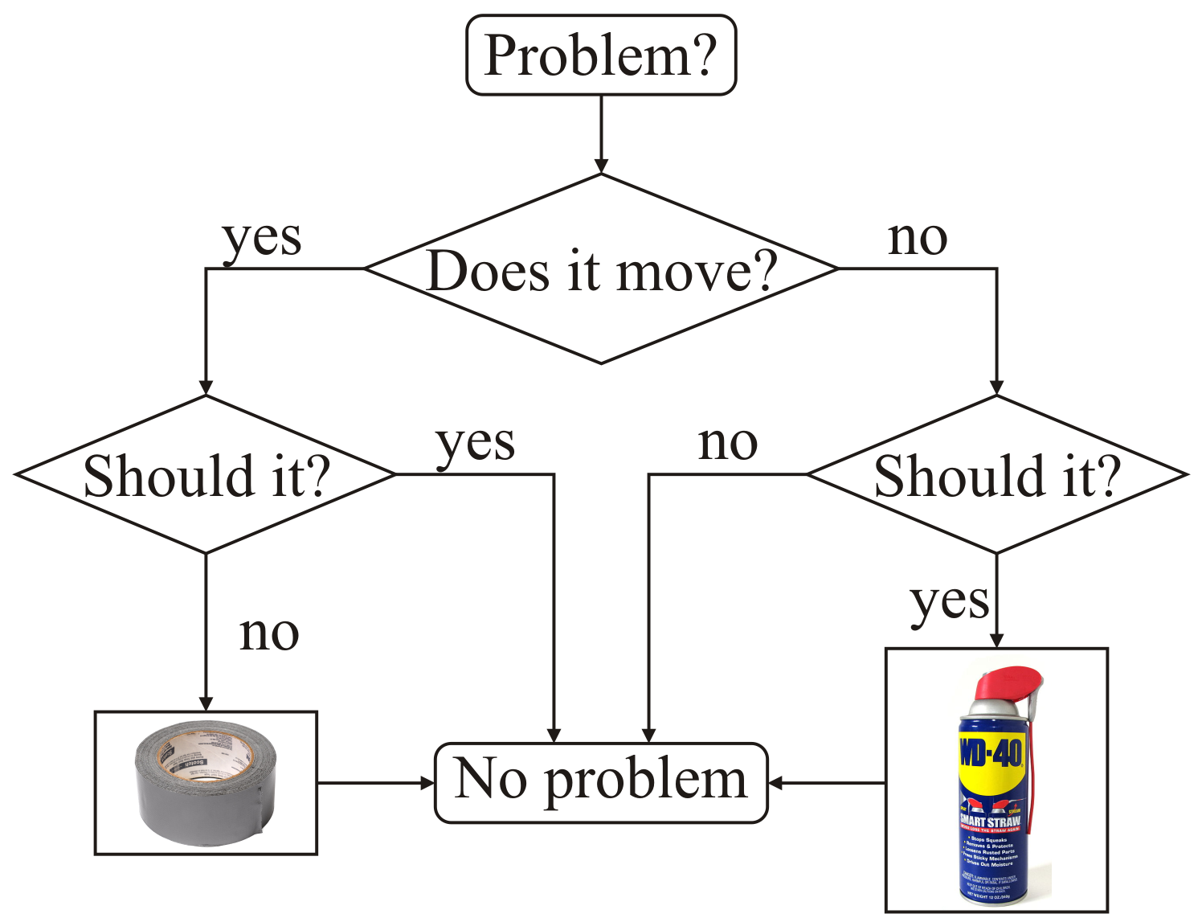
Conditional statements
In programming, we can conditionally execute code if some condition—a Boolean-valued statement—is satisfied (i.e., true)

Slide 4
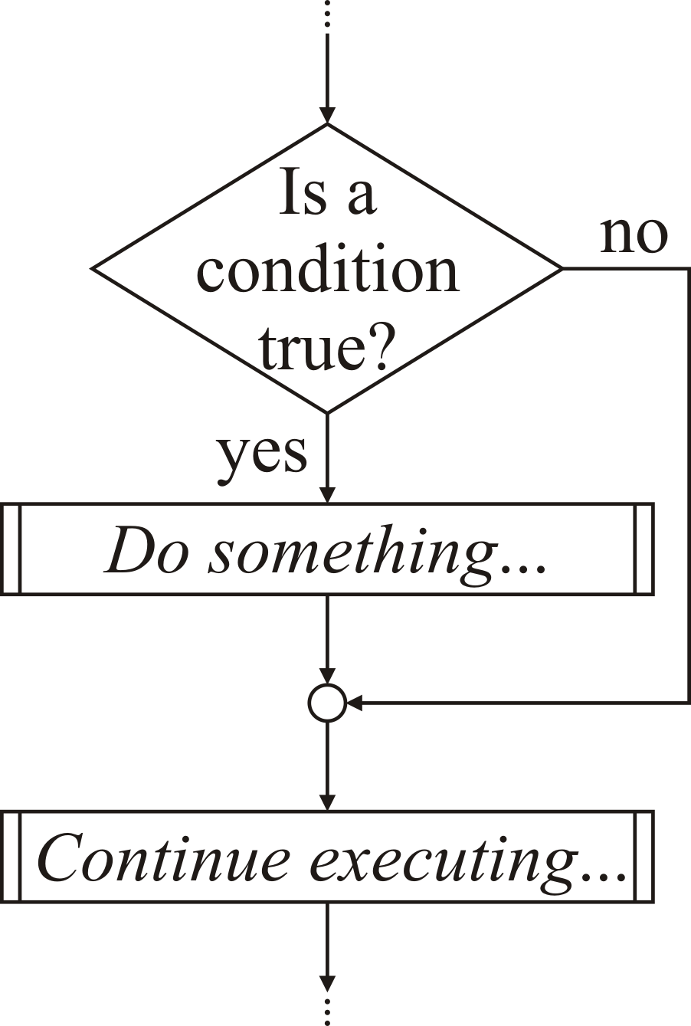
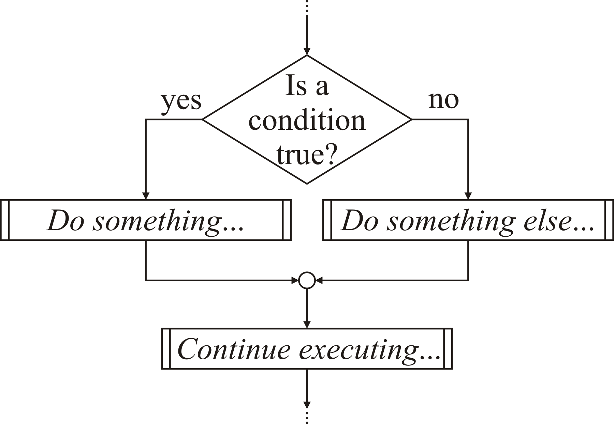
Conditional statements
There are two approaches in computer science to conditional statements:

Slide 5
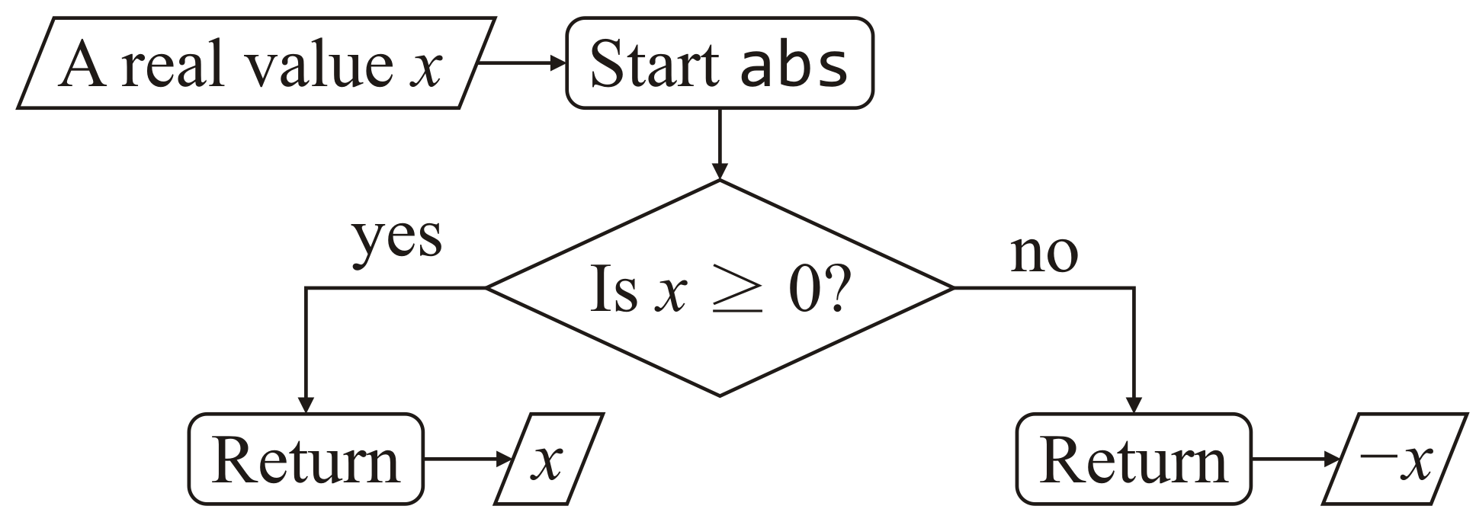
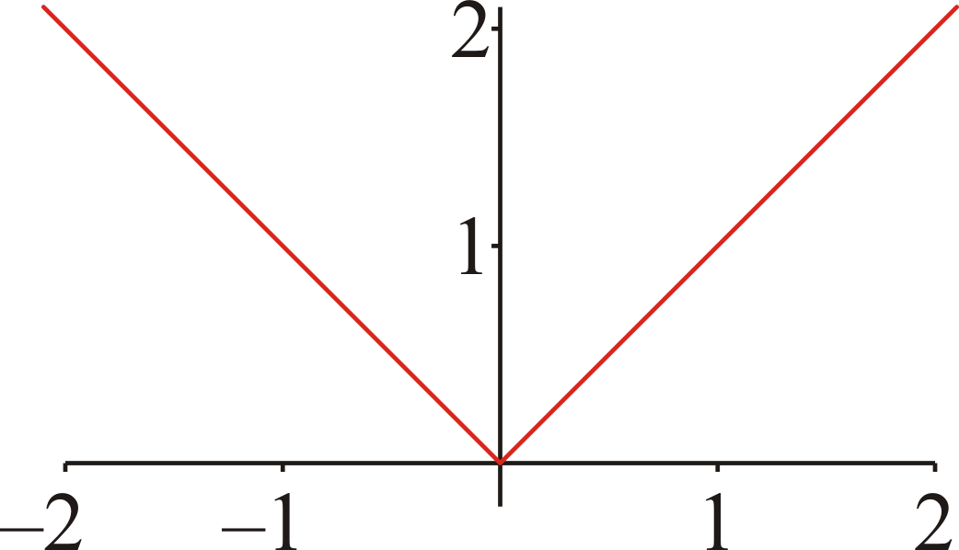
Conditional statements
Many algorithms and mathematical formulas require that some condition be checked, and the code that is executed may differ based on the outcome of the condition
  Consider the absolute value function:

Slide 6
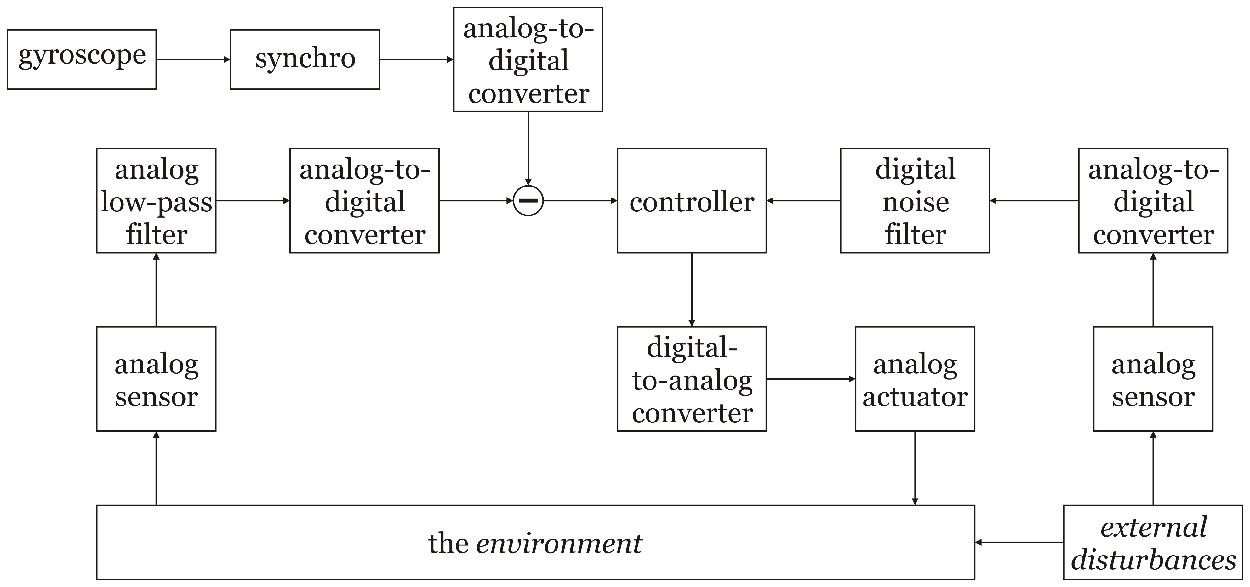
Block diagrams and flow charts
For those programmers who are wondering
“Why are we bothering with flow charts? Let’s just do this now…”
Flow charts and block diagrams are core to engineering:
  Solutions for larger systems are broken up into steps, which step can be solved individually:

Slide 7
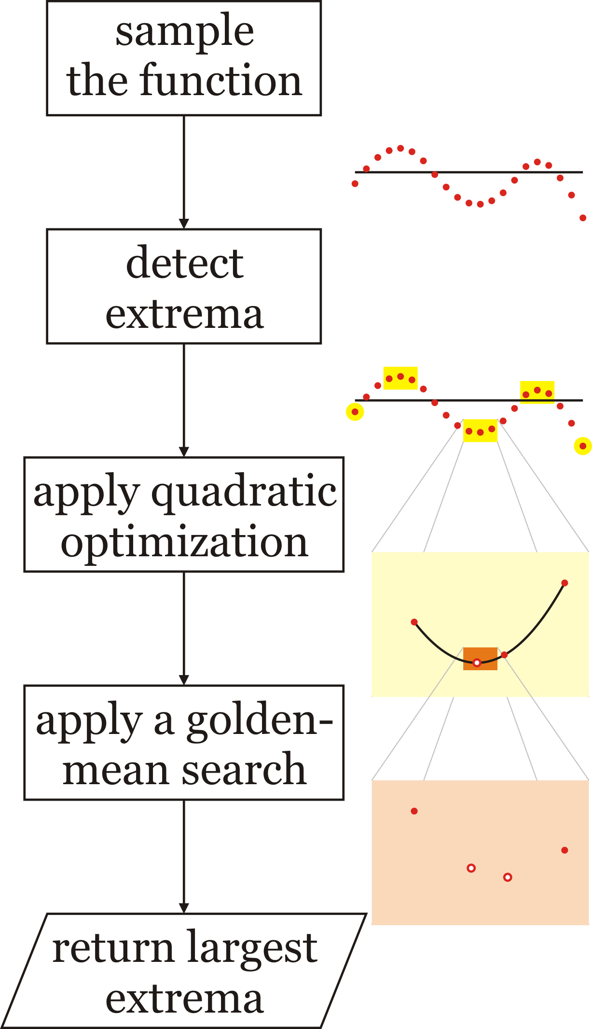
Block diagrams and flow charts
At the time of writing this, this author had to come up with an algorithm to find the extreme values of a function correct to the highest possible floating-point precision
While not so formally, the problem was broken into:
  Appropriate sampling
  Extrema detection
  Application of quadratic optimization to
  localize each extrema
  Application of a golden-mean search to
  further localize each extrema
  Return the largest in absolute value

Slide 8
Conditional statements
In order to execute code only if some condition is satisfied or not, we use a conditional statement:
if ( Boolean-valued condition ) {
// The consequent block or body of statements
// - to be executed if the condition is true
} else {
// The alternative block or body of statements
// - to be executed if the condition is false
}
Even though a conditional statement may have many statements within it, the entire structure is referred to as a conditional statement

Slide 9
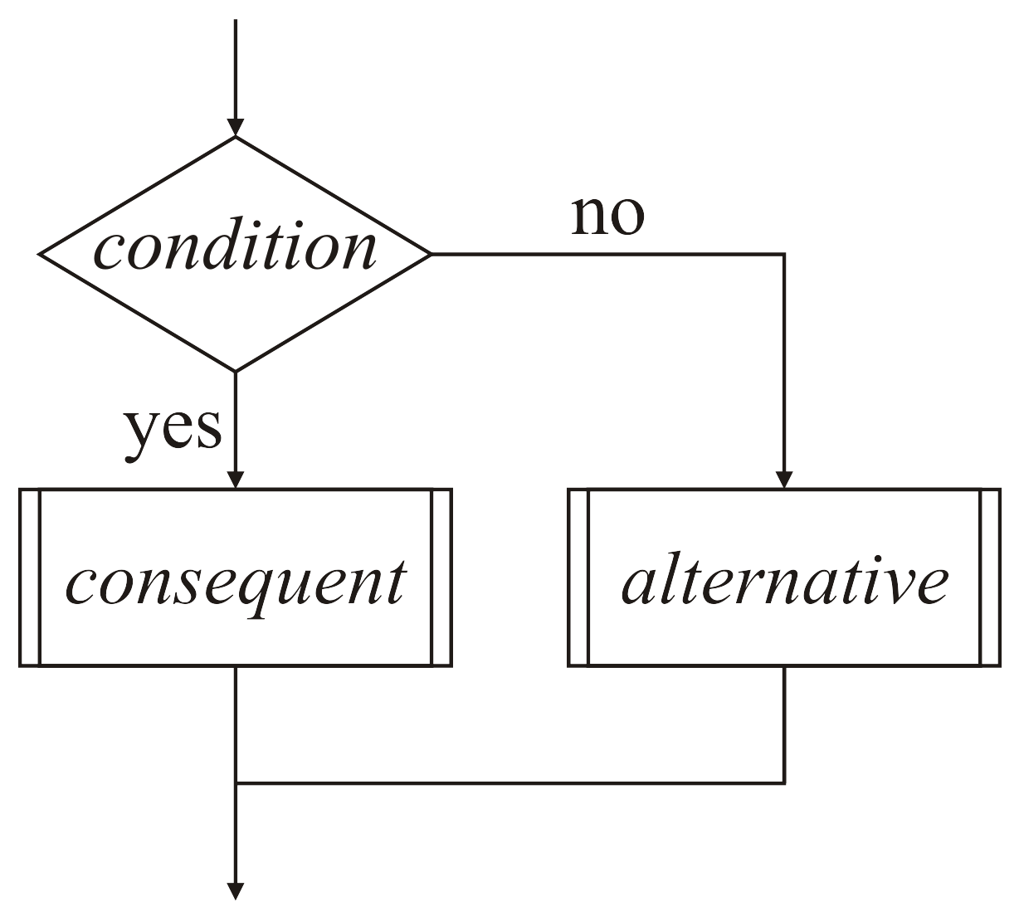
Conditional statements
We represent the condition with a diamond:
if ( Boolean-valued condition ) {
The consequent block of statements
- to be executed if the condition is true
} else {
The alternative block of statements
- to be executed if the condition is false
}
The alternative consequences are labeled
  The possibility of multiple statements
  are represented with additional bars

Slide 10
The absolute-value function
Going back to the absolute-value function, the condition is “Is x ≥ 0?”
double abs( double x ) {
if ( x >= 0.0 ) {
return x;
} else {
return –x;
}
}

Slide 11
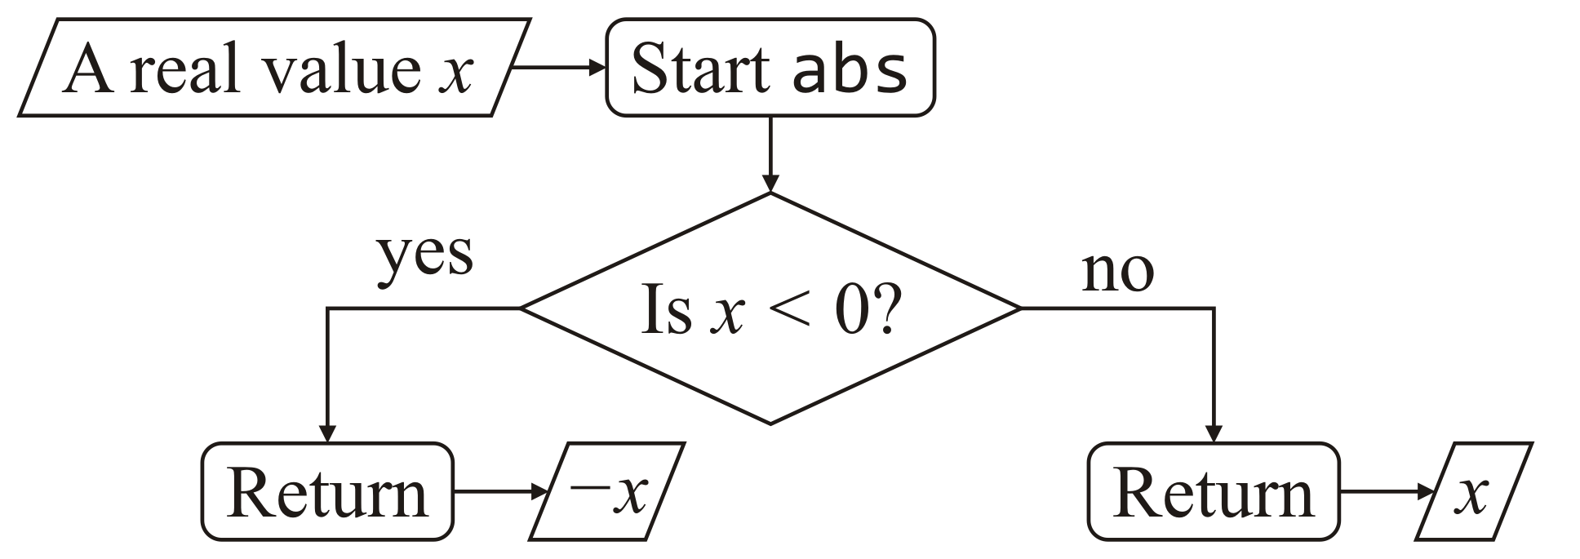
Using complementary operators
If we use the complementary comparison operator, the consequent and alternative bodies are swapped:
double abs( double x ) {
if ( x < 0.0 ) {
return –x;
} else {
return x;
}
}
double abs( double x ) {
if ( x >= 0 ) {
return x;
} else {
return –x;
}
}

Slide 12
Unit step function
The unit step function is a function defined as:
Implement this function with the identifier unit_step and test it in main by printing out the results for three values

Slide 13
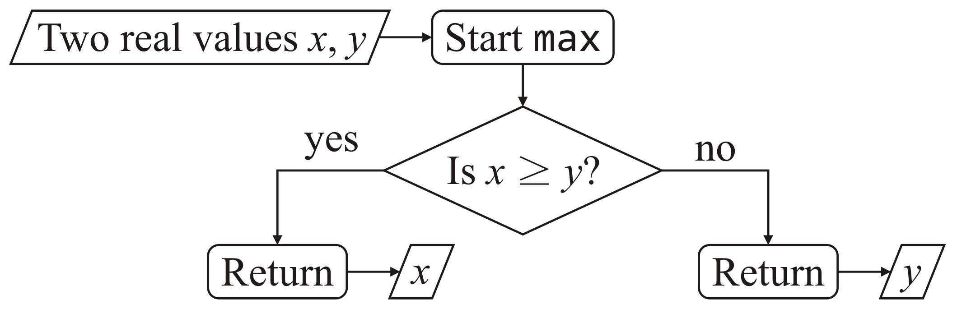
The max function
As a second example, the maximum of two values is also based on a simple condition:
double max( double x, double y ) {
if ( x >= y ) {
return x;
} else {
return y;
}
}

Slide 14
Maximum of three
Implement a function finding the maximum of three values:
    double max( double x, double y, double z );
Follow these steps:
  State your solution in English
  Draw a flow chart
  Write some tests
  Write the function definition
What are the appropriate tests?
  The easiest is to try all permutations of 1.0, 2.0 and 3.0, the maximum of which in all cases should always be 3.0

Slide 15
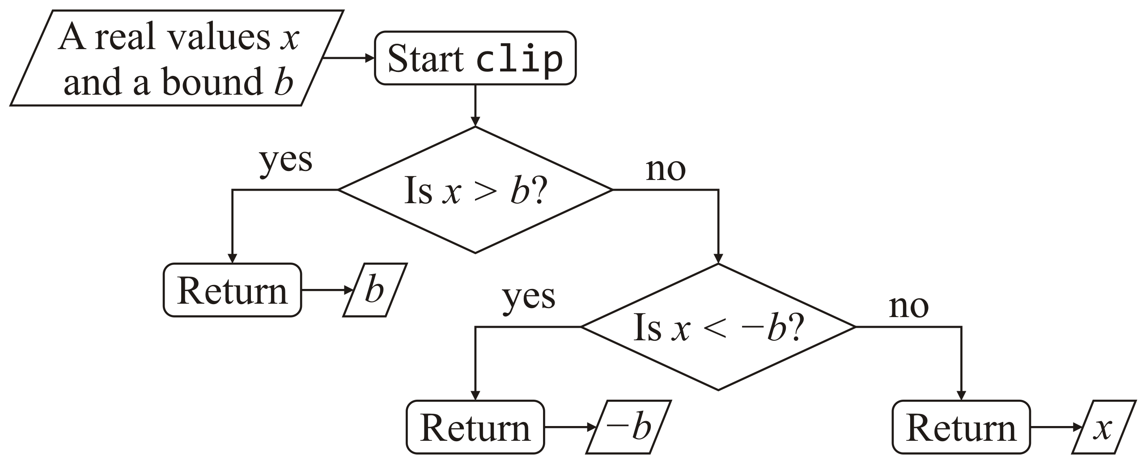
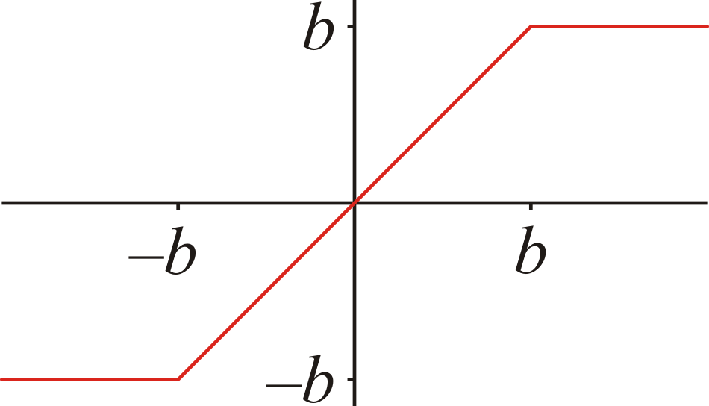
Clipping signals
In engineering, signals (values) often cannot exceed certain bounds
  If a signal x is greater in absolute value than some bound b, the bound is returned
  If x > b, return b;
  Otherwise:
    If x < –b, return –b,
    Otherwise, return x

Slide 16
Clipping signals
Implementing this, we have:
    double clip( double x, double b ) {
    if ( x > b ) {
    return b;
    } else {
    if ( x < -b ) {
    return –b;
    } else {
    return x;
    }
    }
    }
Once a return statement is executed,
no subsequent statements in the function are executed

Slide 17
Clipping signals
If a conditional statement appears within either block of another conditional statement, we say that the statements are “nested”
    double clip( double x, double b ) {
    if ( x > b ) {
    return b;
    } else {
    if ( x < -b ) {
    return –b;
    } else {
    return x;
    }
    }
    }

Slide 18
Clipping signals
If the alternative block is itself a conditional statement, we can beautify the code making it easier to read:
  This is called an else-if statement within the conditional statement
    double clip( double x, double b ) {
    if ( x > b ) {
    return b;
    } else if ( x < -b ) {
    return –b;
    } else {
    return x;
    }
    }

Slide 19
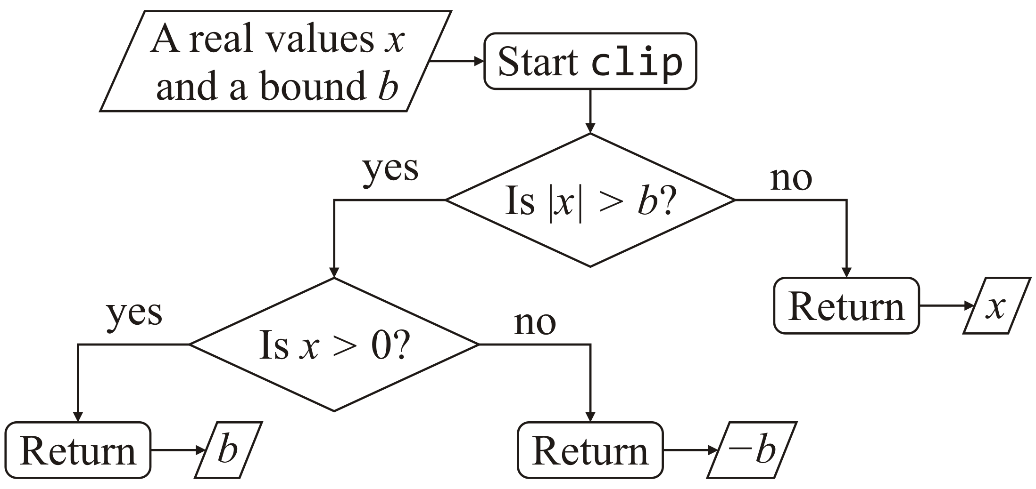
Clipping signals
Most problems have multiple solutions:
  If |x| > b,
    If x > 0, return b,
    Otherwise, return –b;
  Otherwise, return x.

Slide 20
Clipping signals
Implementing alternative version, we have:
    double clip( double x, double b ) {
    if ( abs( x ) > b ) {
    if ( x > 0 ) {
    return b;
    } else {
    return –b;
    }
    } else {
    return x;
    }
    }

Slide 21

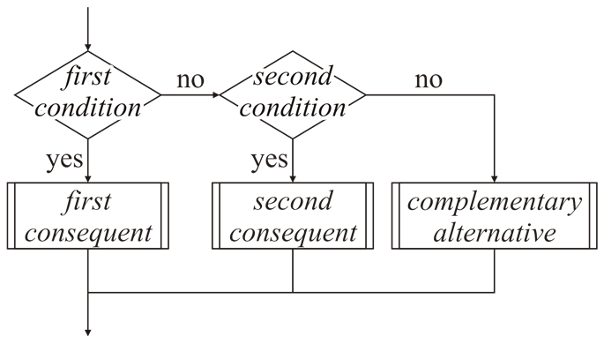
Cascading conditional statements
Such a sequence of if—else-if—··· statements is referred to as cascading conditional statements
    double clip( double x, double b ) {
    if ( x > b ) {
    return b;
    } else if ( x < -b ) {
    return –b;
    } else {
    return x;
    }
    }
Martin Püschel, Song Khon Waterfall

Slide 22
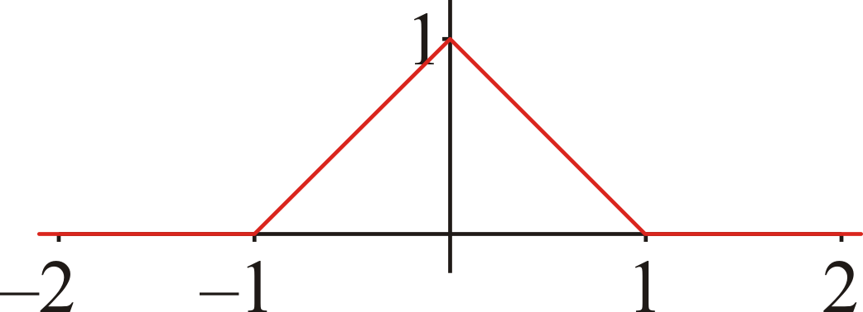
The tent function
A tent function is defined as:
    double tent( double x ) {
    if ( x <= -1.0 ) {
    return 0.0;
    } else if ( x <= 0.0 ) {
    return x + 1.0;
    } else if ( x <= 1.0 ) {
    return 1.0 - x;
    } else {
    return 0.0;
    }
    }
What would the flow chart look like?

Slide 23
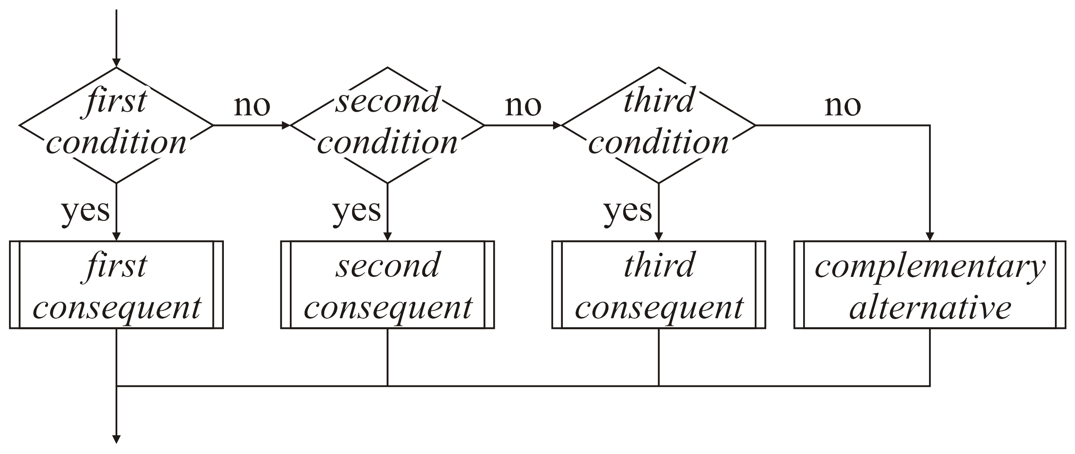
Cascading conditional statements
Cascading conditional statements are represented by this flow chart
  The alternative if complementary to all other consequences
    double tent( double x ) {
    if ( x <= -1.0 ) {
    return 0.0;
    } else if ( x <= 0.0 ) {
    return x + 1.0;
    } else if ( x <= 1.0 ) {
    return 1.0 - x;
    } else {
    return 0.0;
    }
    }

Slide 24
Conditions are simply statements
We can also use the double abs(…) function instead:
    double tent( double x ) {
    if ( abs( x ) >= 1.0 ) {
    return 0.0;
    } else if ( x <= 0.0 ) {
    return x + 1.0;
    } else {
    return 1.0 - x;
    }
    }
or even
    double tent( double x ) {
    if ( abs( x ) >= 1.0 ) {
    return 0.0;
    } else {
    return 1.0 - abs( x );
    }
    }

Slide 25
How not to use cascades
Novice programmers sometimes want to emphasize the conditional checks:
    if ( x >= 0 ) { if ( x == 0 ) {
    // Do something... // Do something...
    } else if ( x < 0 ) { } else if ( x != 0 ) {
    // Do something else... // Do something else...
    } }
Don’t do this:
  The last condition is complementary to the first
  Experienced programmers reading this will be confused
    They expect that there are some values of x that satisfy neither condition
  Maintenance becomes more difficult

Slide 26
Assertions
If mission-critical software requires you to be certain someone doesn’t accidentally change the conditions, this is acceptable:
    #include <cassert>
    if ( x < -1 ) {
    // Do something...
    } else if ( x <= 1 ) {
    // Do something else...
    } else {
    assert ( x > 1 );
    // Do something else, yet again...
    }
assert
  At runtime, this statement executes when the condition is false and prints to console

Slide 27
Common errors with cascades
Consider this code:
      double square_wave( double x ) {
      if ( x <= -1.0 ) {
      return 0.0;
      } else if ( x < 0.0 ) {
      return -1.0;
      } else if ( x > 0.0 ) {
      return 1.0;
      } else if ( x >= 1.0 ) {
      return 0.0;
      } else {
      assert ( 0.0 == x );
      return 0.0;
      }
      }
What is the error in this cascade?

Slide 28
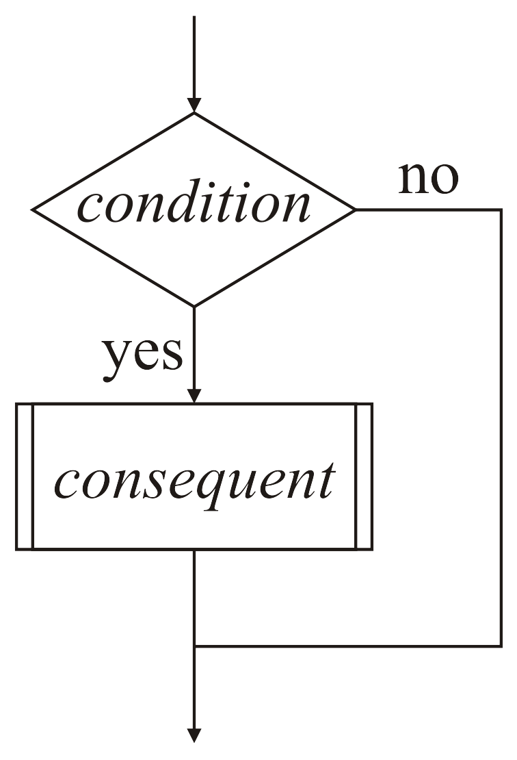
No alternative statement block
If there is nothing to be done if the condition is false, this can be reduced to:
if ( Boolean-valued condition ) {
The consequent block of statements
- to be executed if the condition is true
}

Slide 29
The sinc function
The cardinal sine or sinc function is defined as
An implementation is:
    double sinc( double x ) {
    // Deal with a special case when x = 0:
    if ( 0.0 == x ) {
    return 1.0;
    }
    // The general case
    return std::sin( 3.1415926535897932*x )/
    (3.1415926535897932*x);
    }

Slide 30
Boolean-valued functions
Conditions need not be conditional operators:
    bool is_divsible( int m, int n );
    // Is the argument 'm' divisible by the argument 'n'?
    // - If the remainder is zero, 'm' is divisible by 'n',
    // otherwise, it is not.
    bool is_divsible( int m, int n ) {
    return ((m % n) == 0);
    }

Slide 31
Boolean-valued functions
We can then use this in a conditional statement:
    int factor_out_bad_luck_once( int n );
    int factor_out_bad_luck_once( int n ) {
    if ( is_divisible( n, 13 ) ) {
    return n/13;
    } else {
    return n;
    }
    }

Slide 32
Recursive function calls
Recall our fast sine function:
  This returns a reasonable approximation if 0 ≤ x ≤ π/2
    double fast_sin( double x ) {
    return ((
    -0.11073981636184074*x - 0.057385341027109429
    )*x + 1.0)*x;
    }
What happens if –π/2 ≤ x < 0?
  Recall that sin(–x) = –sin(x) or the equivalent statement sin(x) = –sin(–x)

Slide 33
Recursive function calls
With the property that sin(x) = –sin(–x), we may proceed as follows:
    double fast_sin( double x ) {
    if ( x < 0.0 ) {
    return -fast_sin( -x );
    }
    return ((
    -0.11073981636184074*x - 0.057385341027109429
    )*x + 1.0)*x;
    }
This is called a recursive function call
  If fast_sin is called with the argument -0.3, the first condition is true
    This first condition calls fast_sin( -(-0.3) ) == fast_sin( 3.0 ),
    so now the first condition is false

Slide 34
Summary
Following this lesson, you now:
  Understand the format of a conditional statement:
    A Boolean-valued condition,
    a consequent block of statements to be executed if the condition is true, and
    an alternative block of statements to be executed if the condition is false
  We used simple, nested and cascading conditional statements to implement numerous functions

Slide 35
References
[1] Wikipedia
https://en.wikipedia.org/wiki/Conditional_(computer_programming)

Slide 36



Colophon
These slides were prepared using the Georgia typeface. Mathematical equations use Times New Roman, and source code is presented using Consolas.
The photographs of lilacs in bloom appearing on the title slide and accenting the top of each other slide were taken at the Royal Botanical Gardens on May 27, 2018 by Douglas Wilhelm Harder. Please see
https://www.rbg.ca/
for more information.

Slide 37
Disclaimer
These slides are provided for the ece 150 Fundamentals of Programming course taught at the University of Waterloo. The material in it reflects the authors’ best judgment in light of the information available to them at the time of preparation. Any reliance on these course slides by any party for any other purpose are the responsibility of such parties. The authors accept no responsibility for damages, if any, suffered by any party as a result of decisions made or actions based on these course slides for any other purpose than that for which it was intended.

